Slide 1

What’s for Dinner? A Serious Eats Web Scraping Project
Josefa Sullivan @ZefaSullivan
Notes:
It’s healthier and more affordable to cook at home
But it can take a lot of energy to decide what you want to eat and what groceries you need at the end of a long day
Serious eats has great content that can be utilized to make tools that make it easier to cook at home which can increase their userbase

Slide 2
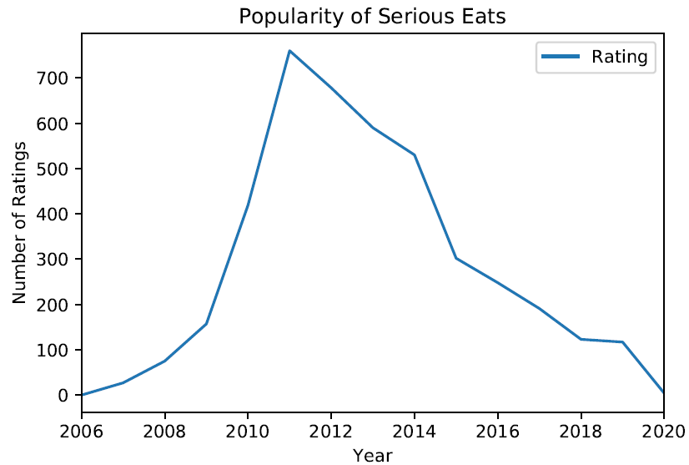
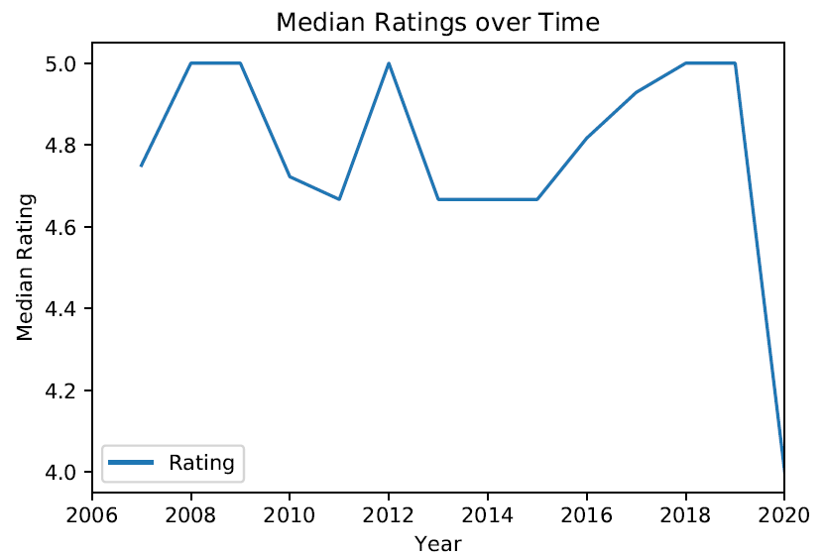
User participation on SeriousEats.com has declined since 2011
Notes:
Graph of ratings peak at 2011-2012 after Serious Eats won two James Beard awards for Best Food Blog and webcast but it’s been declining since then
Need to find ways to increase participation

Slide 3
Objectives:
Identify features of the most successful recipes
Identify areas to generate new content
Build a recipe suggestion tool to make it easier to find recipes

Slide 4
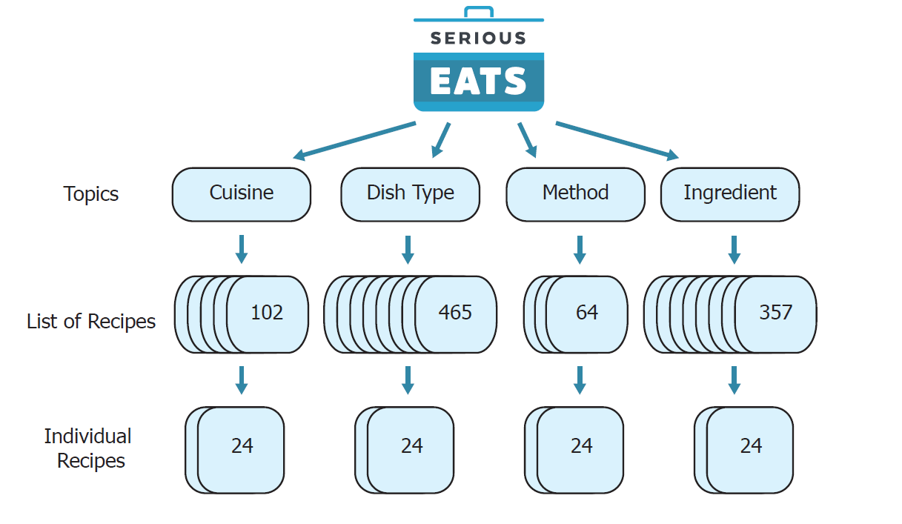
Scrapy Pipeline Design for SeriousEats.com

Slide 5
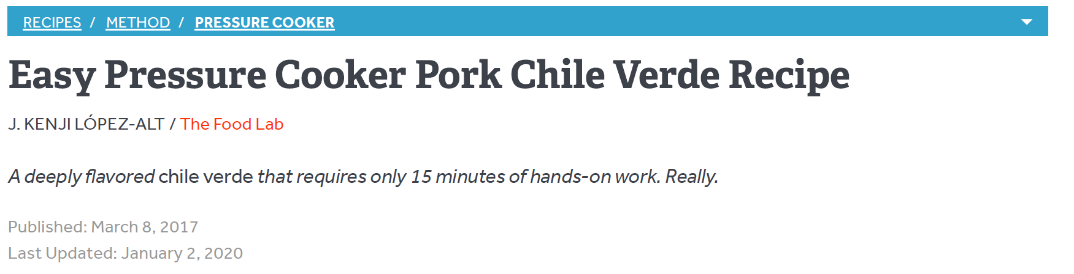
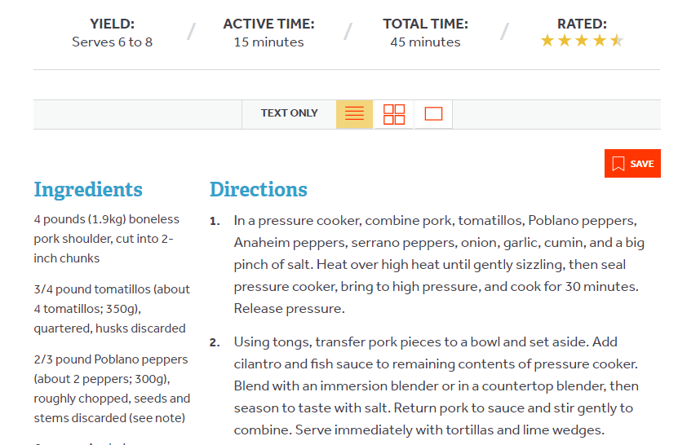
Features extracted from each recipe
12,620 Recipes
Features (13):
- Title
- Link
- Topic
- Subtopic
- Author
- Photographer
- Date
- Servings
- Time
- Rating
- Ingredient Text
- Directions Text
Notes:
My hope was to identify features that strongly correlated with recipe rating, however none of the numerical features had any strong correlation
Alas nothing here. I think more advanced machine learning techniques will be needed to determine features

Slide 6
Are any numerical features strongly correlated with rating?
Feature Name | Pearson Correlation
Ingredient Word Count | 0.07
Title Length | 0.06
Ingredient Number | 0.02
Direction Number | 0.004
Direction Word Count | 0.02
Cook Time | TBD
Servings | TBD

Slide 7
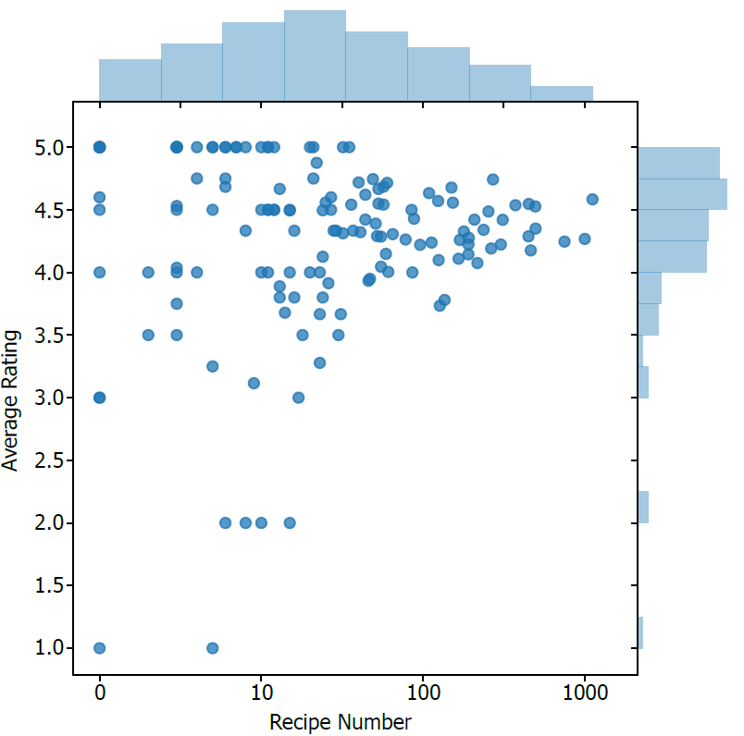
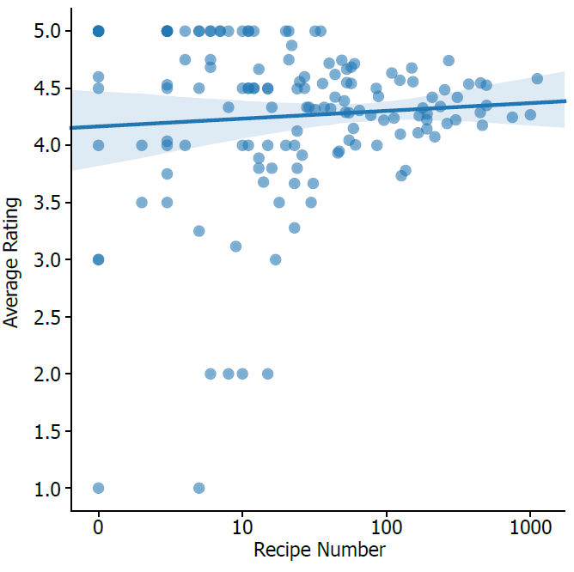
Authors with more than 30 recipes tend to have higher ratings
Notes:
There is a separation in recipe quality when we look by individual authors. Authors who have written more recipes tend to have higher ratings on average
Suggest using these highly rated authors to generate the new content. But what to make?

Slide 8
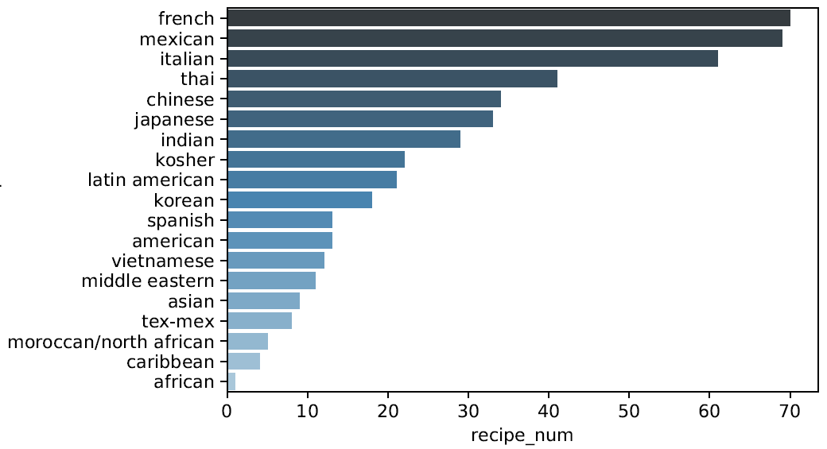
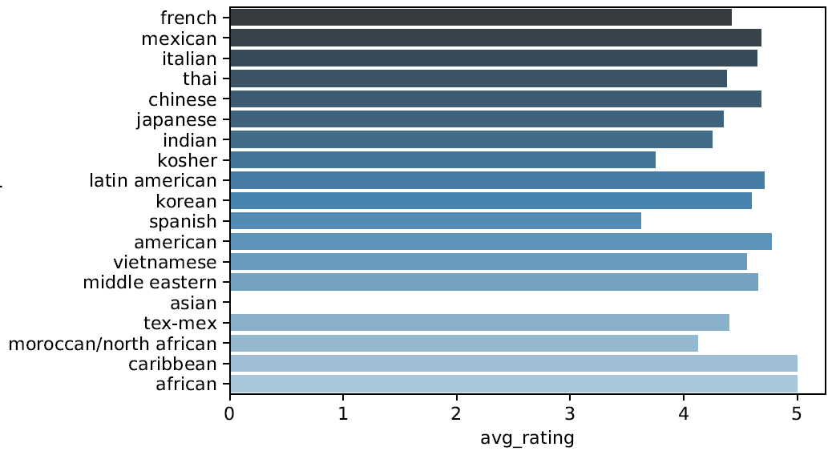
African and Caribbean recipes are a promising area for development
Recipe Number
Average Rating
Notes:
Despite the few number of recipes, the ratings are very high

Slide 9

What should I make for dinner?
Built a tool to suggest a recipe based off the ingredients you have
Used cosine similarity to find the recipe that closest matches the ingredients you chose
Image Credit: Vit Novotny and Michael Penkov
Notes:
New content may not be enough to draw more users. If you have tools that make life easier, then I think you would see an increase in readership.
We all have had those days where you’re just too tired to decide what to make after a long day’s work. The healthier option is to cook at home but sometimes you just don’t have the energy. I built a prototype to make that process easier

Slide 10
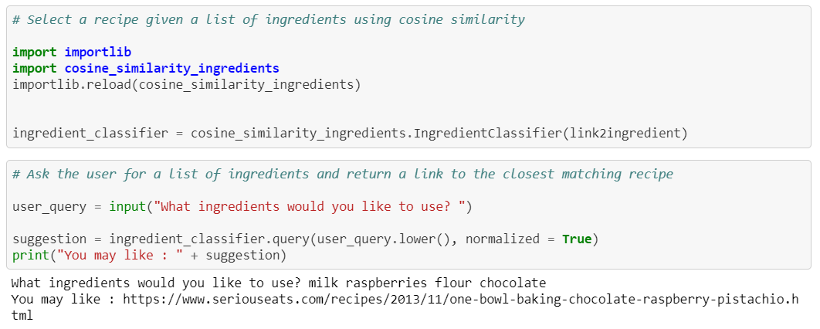
What should I make for dinner?
Notes:
Can put in whatever ingredients you have in your fridge or use it to find new recipes based on your favorite ingredients
Serious Eats current search tool returns over 20 suggestions which have some but not all of your specified items

Slide 11



Going Forward
Create more African and Caribbean recipes
Utilize data to build tools to increase user base
What should I eat tonight? search
Personalized recipe suggestions for users based on prior rating history
Josefa-Sullivan
josefa-sullivan
@ZefaSullivan
Notes:
Modify to take your favorite SE recipe and return another suggestion
Improvements : identify bi- and trigrams to better score ingredients
Incorporate ratings to return only highly rated recipes
Collaborate with a meal plan service to provide recipes based on user preferences

Slide 12
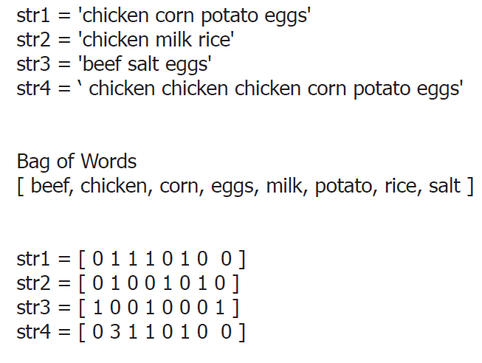
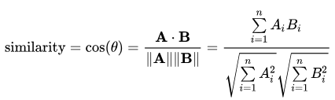
Calculating cosine similarity to normalize term frequency

